Slide 1
Notation of metric spaces equivalence

Slide 2

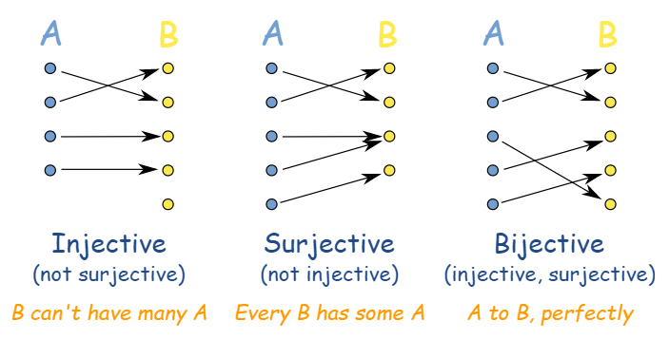
Some terms
A metric space is isometric to a metric space if there is a bijection between and that preserves distances.
Homeomorphism
a correspondence between two figures or surfaces or other geometrical objects, defined by a one-to-one mapping that is continuous in both directions
Also known as topological isomorphism or bicontinuous function is a bijective and continuous function
A bilipschitz mapping is injective and is in fact a homeomorphism onto its image.
A metric space X is isometric to a metric space Y if there is a bijection f between X and Y that preserves distances. (i.e)

Slide 3
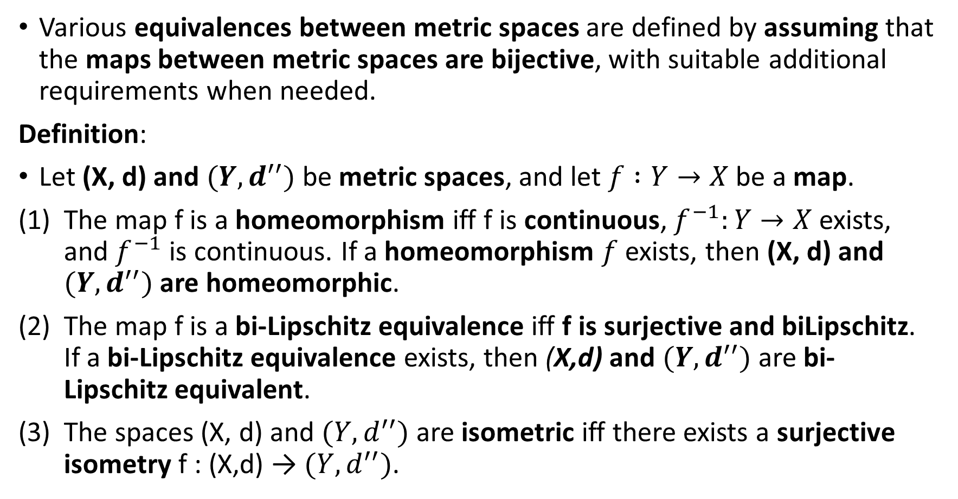
Various equivalences between metric spaces are defined by assuming that the maps between metric spaces are bijective, with suitable additional requirements when needed.
Definition:
Let (X, d) and $(Y, d^{′′})$ be metric spaces, and let $f :Y→X$ be a map.
The map f is a homeomorphism iff f is continuous, $f^{−1}:Y→X$ exists, and $f^{−1}$ is continuous. If a homeomorphism $f$ exists, then (X, d) and $(Y, d^{′′})$ are homeomorphic.
The map f is a bi-Lipschitz equivalence iff f is surjective and biLipschitz. If a bi-Lipschitz equivalence exists, then (X,d) and $(Y, d^{′′})$are bi-Lipschitz equivalent.
The spaces (X, d) and $(Y, d^{′′})$ are isometric iff there exists a surjective isometry f : (X,d) → $(Y, d^{′′})$.

Slide 4
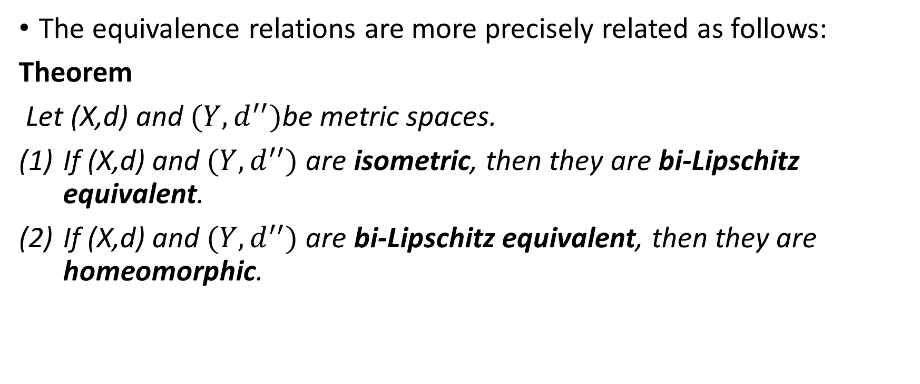
The equivalence relations are more precisely related as follows:
Theorem
Let (X,d) and $(Y, d^{′′})$be metric spaces.
If (X,d) and $(Y, d^{′′})$ are isometric, then they are bi-Lipschitz equivalent.
If (X,d) and $(Y, d^{′′})$ are bi-Lipschitz equivalent, then they are homeomorphic.

Slide 5
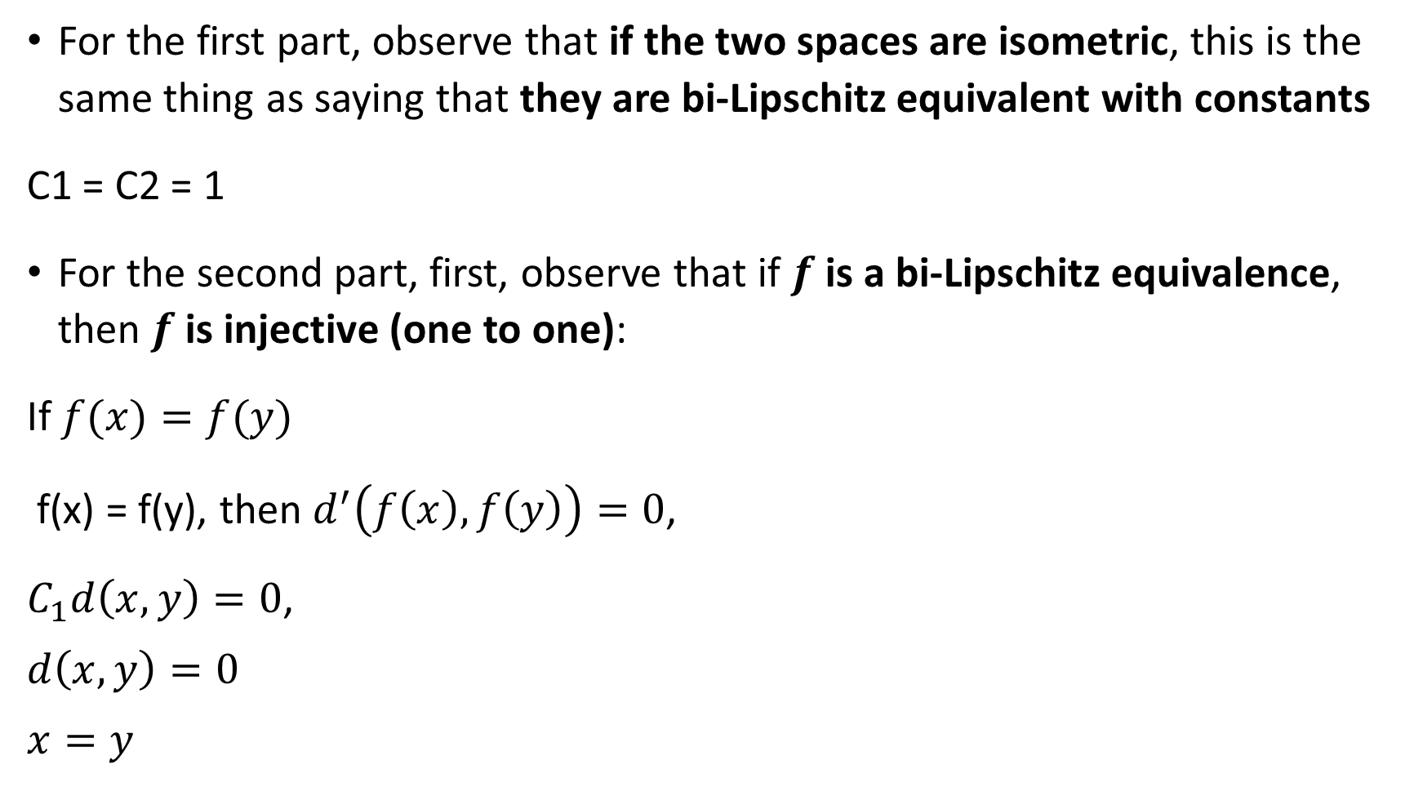
Proof
For the first part, observe that if the two spaces are isometric, this is the same thing as saying that they are bi-Lipschitz equivalent with constants
C1 = C2 = 1
For the second part, first, observe that if $f$ is a bi-Lipschitz equivalence, then $f$ is injective (one to one):
If $f(x)=f(y)$
f(x) = f(y), then $d^{′}\left(f\left(x\right),f\left(y\right)\right)=0$,
$C_{1}d\left(x,y\right)=0$,
$$d\left(x,y\right)=0$$
$$x=y$$

Slide 6
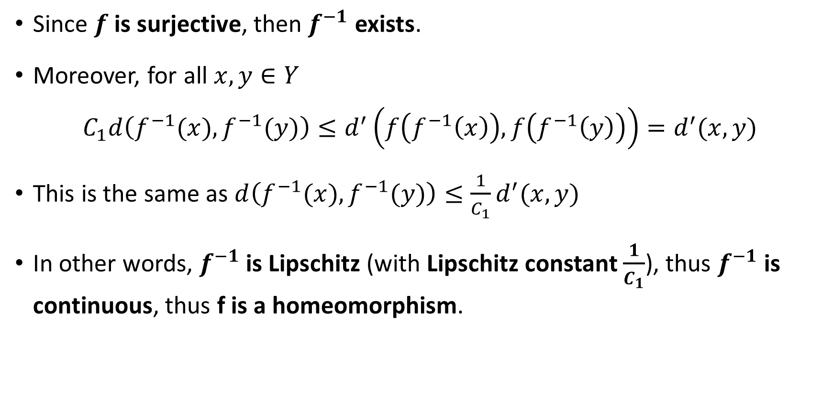
Proof
Since $f$ is surjective, then $f^{−1}$ exists.
Moreover, for all $x,y∈Y$
$$C_{1}d\left(f^{−1}(x),f^{−1}(y)\right)≤d^{′}\left(f\left(f^{−1}\left(x\right)\right),f\left(f^{−1}\left(y\right)\right)\right)=d^{′}(x,y)$$
This is the same as $d\left(f^{−1}(x),f^{−1}(y)\right)≤\frac{1}{C_{1}}d^{′}(x,y)$
In other words, $f^{−1}$ is Lipschitz (with Lipschitz constant $\frac{1}{C_{1}}$), thus $f^{−1}$ is continuous, thus f is a homeomorphism.

Slide 7
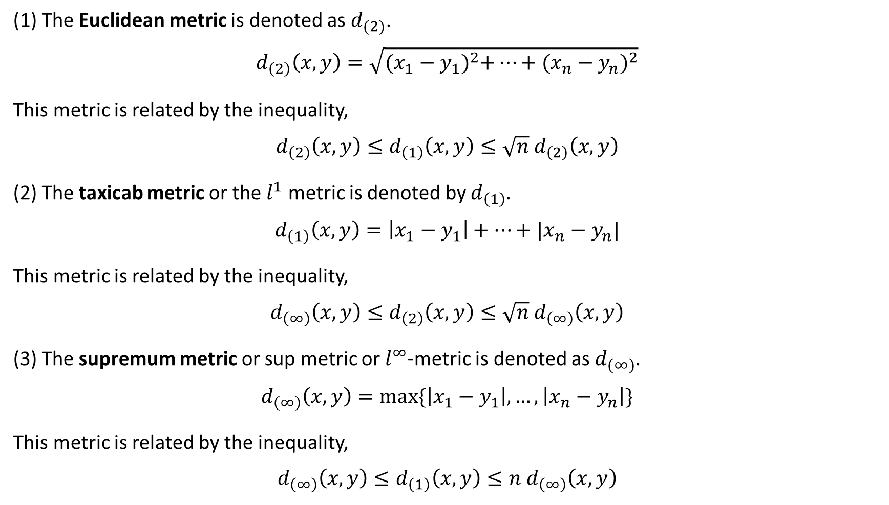
Notation of metric spaces equivalence
(1) The Euclidean metric is denoted as $d_{(2)}$.
$$d_{\left(2\right)}\left(x,y\right)=\sqrt{{(x_{1}−y_{1})}^{2}+…+{(x_{n}−y_{n})}^{2}}$$
This metric is related by the inequality,
$$d_{\left(2\right)}\left(x,y\right)≤d_{\left(1\right)}\left(x,y\right)≤\sqrt{n} d_{\left(2\right)}\left(x,y\right)$$
(2) The taxicab metric or the $l^{1}$ metric is denoted by $d_{\left(1\right)}$.
$$d_{\left(1\right)}\left(x,y\right)=\left|x_{1}−y_{1}\right|+…+|x_{n}−y_{n}|$$
This metric is related by the inequality,
$$d_{\left(∞\right)}\left(x,y\right)≤d_{\left(2\right)}\left(x,y\right)≤\sqrt{n} d_{\left(∞\right)}\left(x,y\right)$$
(3) The supremum metric or sup metric or $l^{∞}$-metric is denoted as $d_{(∞)}$.
$$d_{\left(∞\right)}\left(x,y\right)=max⁡\{\left|x_{1}−y_{1}\right|,…,\left|x_{n}−y_{n}\right|\}$$
This metric is related by the inequality,
$$d_{\left(∞\right)}\left(x,y\right)≤d_{\left(1\right)}\left(x,y\right)≤n d_{\left(∞\right)}\left(x,y\right)$$

Slide 8
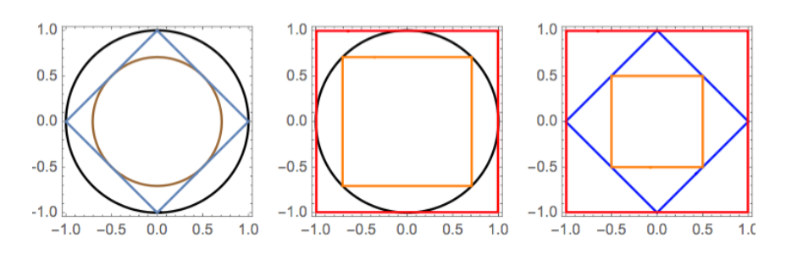
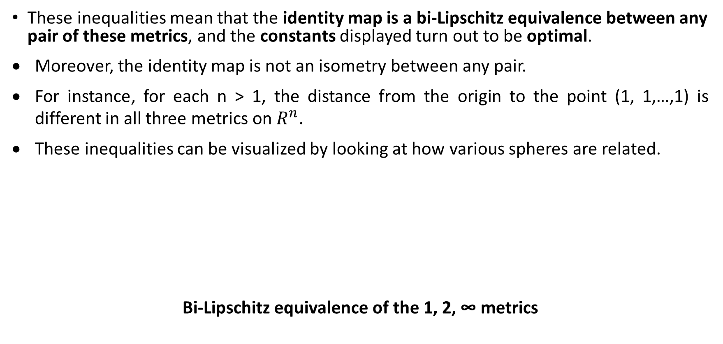
These inequalities mean that the identity map is a bi-Lipschitz equivalence between any pair of these metrics, and the constants displayed turn out to be optimal.
Moreover, the identity map is not an isometry between any pair.
For instance, for each n > 1, the distance from the origin to the point (1, 1,…,1) is different in all three metrics on $R^{n}$.
These inequalities can be visualized by looking at how various spheres are related.
Bi-Lipschitz equivalence of the 1, 2, ∞ metrics

